Slide 1
School of Engineering and Technology
Course: Fundamentals of Data Science
Module-2
Mathematical Preliminaries

Slide 2
Module-2:
Mathematical Preliminaries:
Probability—Descriptive Statistics—Correlation Analysis and Regression.
Data Munging: Properties of Data—Collecting Data—Cleaning Data—Crowdsourcing.

Slide 3
CONTENTS
2.1 PROBABILITY
2.2 DESCRIPTIVE STATISTICS
AND EXAMPLES
2.3 CORRELATION ANALYSIS & REGRESSION
2.4 REGRESSION
2.5 DATA MUNGING
2.6 PROPERTIES OF DATASET
2.7 COLLECTING DATA
2.8 CLEANING DATA
2.9 CROWDSOURCING

Slide 4

Overview of Mathematical Preliminaries
1
Algebra
Understanding basic algebraic operations, including variables, equations, and inequalities, forms the building blocks for solving problems in data science.
2
Calculus
Calculus concepts like derivatives and integrals are valuable for optimizing models and understanding trends within data.
3
Linear Algebra
Linear algebra, specifically vectors and matrices, is fundamental for representing and manipulating data in high-dimensional spaces.
4
Statistics
Statistical methods are essential for analyzing data, drawing inferences, and making predictions based on observed patterns.

Slide 5
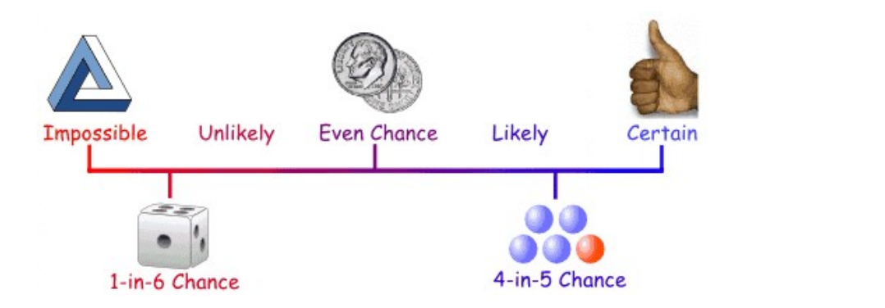
2.1 Probability
Probability is the chance that something will happen — how likely it is that some event will happen.
Probability of an event happening, $P(E)=\frac{no.of ways it can happen, n(E) }{Total number of outcomes n(T)}$
Probability is the measure of the likelihood that an event will occur. Probability is quantified as a number between 0 and 1, where 0 indicates impossibility and 1 indicates certainty.

Slide 6
Why Probability is important?
In certain areas of our everyday lives, confusion and randomness exist and having a strong knowledge of probability allows us to make sense of these uncertainties.
Knowing about chance allows us to make educated judgments on what is likely to happen, based on a trend of previously collected data or estimation.
How to use Probability in Data Science?
Data Science also makes use of statistical inferences to forecast or interpret computer patterns, while statistical inferences use data distribution of probabilities. Therefore it is important to know the likelihood and its implementations to work effectively on data science problems.
Examples: Predicting customer behavior, assessing risks in finance, and determining the effectiveness of a medical treatment.

Slide 7
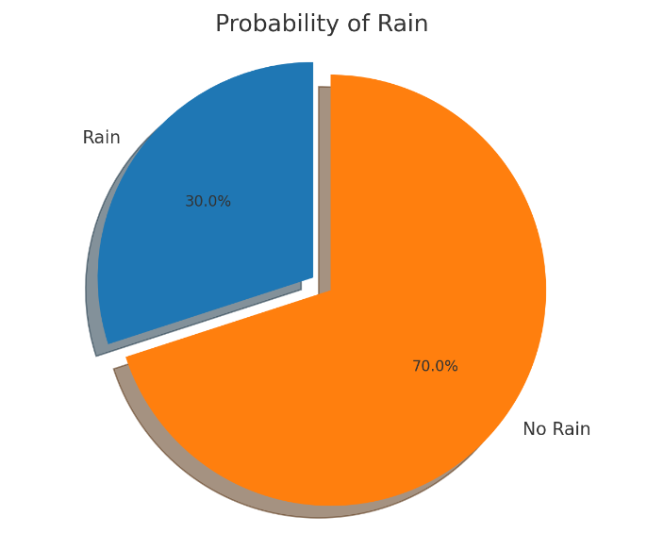

Slide 8
Probability vs. Statistics
Probability deals with predicting the likelihood of future events, while statistics analyzes the frequency of past events.
Probability is theoretical branch of mathematics on the consequences of definitions, while statistics is applied mathematics trying to make sense of real-world observations.

Slide 9
Terms in Probability
Term | Definition
Sample Space | Set of all possible outcomes in a probability experiment. For instance, in a coin toss, it’s “head” and “tail”.
Sample Point | One of the possible results in an experiment. For example, in rolling a fair six-sided dice, sample points are 1 to 6.
Experiment | A process or trial with uncertain results. Examples include coin tossing, card selection, or rolling a die.
Event | A subset of the sample space representing certain outcomes. Example: getting “1” when rolling a die.
Favorable Outcome | An outcome that produces the desired or expected consequence.

Slide 10
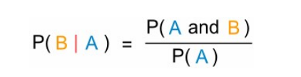
What is Conditional Probability?
Conditional probability is a measure of the likelihood of an occurrence (some particular circumstance occurring), provided that another occurrence has occurred (by inference, hypothesis, conclusion, or evidence).
https://www.hitbullseye.com/Probability-Examples.php (more examples)
https://www.analyticsvidhya.com/blog/2017/02/basic-probability-data-science-with-examples/

Slide 11

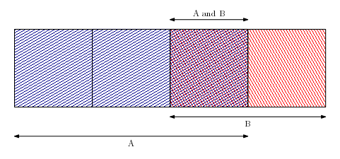
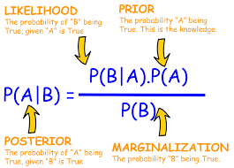
Bayes Theorem
Bayes theorem lets us update our likelihood estimate of A in response to knowledge of B:

Slide 12
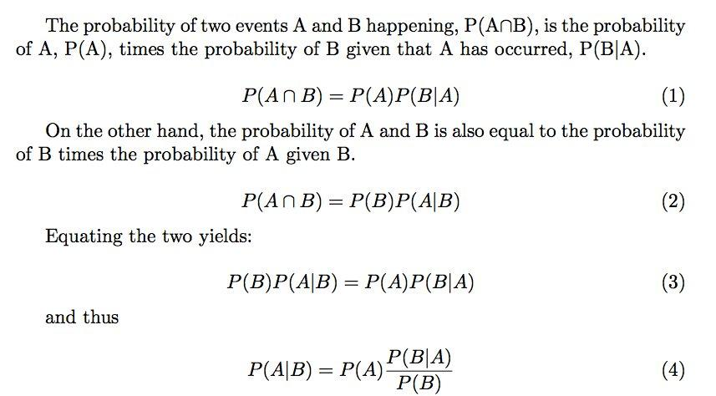
Proof of Bayes Theorem

Slide 13
Example 1: A coin is thrown 3 times .what is the probability that atleast one head is obtained? Sol: Sample space = [HHH, HHT, HTH, THH, TTH, THT, HTT, TTT] Total number of ways = 2 × 2 × 2 = 8. Fav. Cases = 7 P (A) = 7/8 OR P (of getting at least one head) = 1 – P (no head)⇒ 1 – (1/8) = 7/8
Example 2: Find the probability of getting a numbered card when a card is drawn from the pack of 52 cards. Sol: Total Cards = 52.
Numbered Cards = (2, 3, 4, 5, 6, 7, 8, 9, 10) 9 from each suit 4 × 9 = 36 P (E) = 36/52 = 9/13

Slide 14
Example: A coin is thrown 3 times .what is the probability that atleast one head is obtained?
Find the total number of possible outcomes, then find the number of outcomes with no heads. Subtract the probability of getting no heads from 1 to find the probability of getting at least one head.
Sample space = [HHH, HHT, HTH, THH, TTH, THT, HTT, TTT]
Step 1: Find the total number of possible outcomes.
There are 2 possible outcomes for each coin toss (heads or tails).
Multiply the number of possible outcomes for each toss to find
the total number of possible outcomes.
2 X 2 X 2 = 8
Step 2: Find the number of outcomes with no heads.
There is only one outcome with no heads (TTT).

Slide 15
Step 3: Find the probability of getting no heads.
Divide the number of outcomes with no heads (1) by the
total number of possible outcomes (8).
p(no heads) = 1/8
Step 4: Find the probability of getting at least one head.
The probability of getting at least one head is the
complement of the probability of getting no heads. So:
P(at least one head)=1−P(no heads)=1−1/8​ =7/8.
Final Answer:
The probability of getting at least one head in 3 coin tosses is:
7/8.

Slide 16
2. Find the probability of getting a numbered card when a card is drawn from the pack of 52 cards.
Sol: A standard deck of 52 cards consists of 4 suits (hearts, diamonds, clubs, and spades), and each suit contains 13 cards:
3 face cards: Jack (J), Queen (Q), and King (K).
10 numbered cards: Ace (considered as 1), 2, 3, 4, 5, 6, 7, 8, 9, and 10.
Step 1: Count the number of numbered cards

Slide 17
Each suit has the following numbered cards: Ace (1), 2, 3, 4, 5, 6, 7, 8, 9, 10 — totaling 10 numbered cards per suit.
Since there are 4 suits, the total number of numbered cards in the deck is:
10×4=40
Step 2:Total possible outcomes.
The total number of possible outcomes when drawing a card from
the deck is 52 (since there are 52 cards in total).

Slide 18
Step 3: Probability of drawing a numbered card
The probability of drawing a numbered card is the ratio of the number of numbered cards to the total number of cards in the deck:
P( numbered card) = Number of numbered cards
Total number of cards = 40/52= 10/13
Final Answer:The probability of drawing a numbered card from a standard deck of 52 cards is:
10/13.

Slide 19
2.2 Descriptive statistics : https://www.geeksforgeeks.org/descriptive-statistic/
Descriptive statistics are brief informational coefficients that summarize a given data set, which can be either a representation of the entire population or a sample of a population. Descriptive statistics are broken down into measures of central tendency and measures of variability.
Types of Descriptive Statistics
Measures of Central Tendency
Measure of Variability
Measures of Frequency Distribution

Slide 20
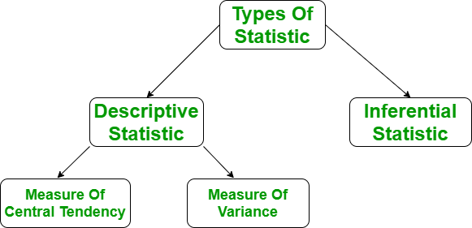

Slide 21

Descriptive statistics types in detail:
There are three main measures of central tendency:
Mean
Mode
Median
Mean
It is the sum of observations divided by the total number of observations. It is also defined as average which is the sum divided by count.

Slide 22
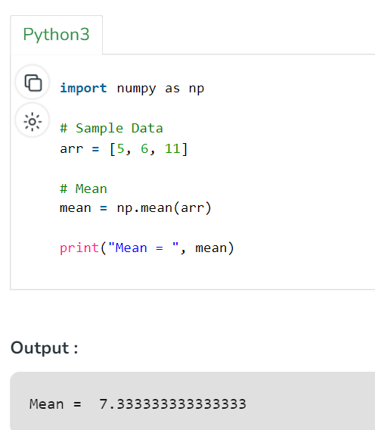
Example:

Slide 23
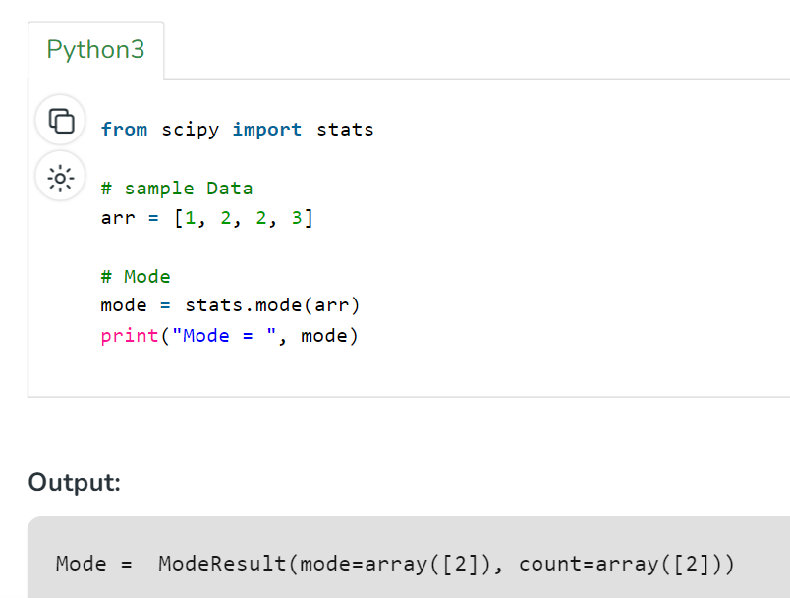
Mode
It is the value that has the highest frequency in the given data set. The data set may have no mode if the frequency of all data points is the same. Also, we can have more than one mode if we encounter two or more data points having the same frequency.

Slide 24
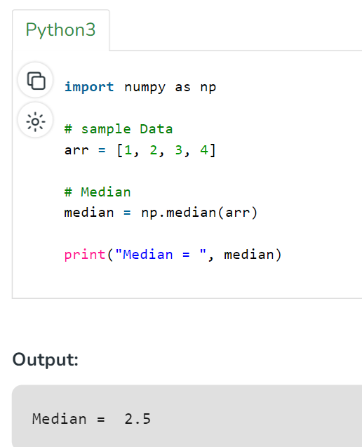
Median
It is the middle value of the data set. It splits the data into two halves. If the number of elements in the data set is odd then the center element is the median and if it is even then the median would be the average of two central elements.

Slide 25
Mean, Median, and Mode
What can we learn from looking at a group of numbers?
In Machine Learning/Data Science (and in mathematics) there are often three values that interests us:
Mean - The average value
Median - The mid point value
Mode - The most common value

Slide 26
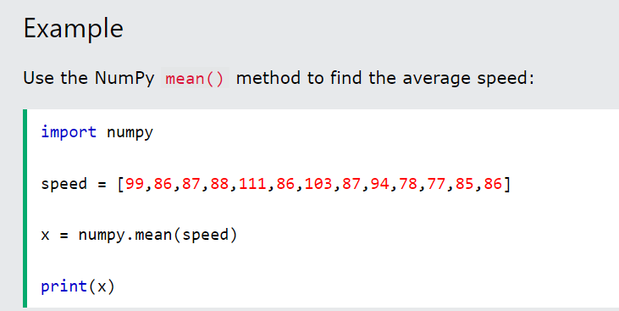
Example: We have registered the speed of 13 cars:
speed = [99,86,87,88,111,86,103,87,94,78,77,85,86]
The mean value is the average value.
To calculate the mean, find the sum of all values, and divide the sum by the number of values.
(99+86+87+88+111+86+103+87+94+78+77+85+86) / 13 = 89.77

Slide 27
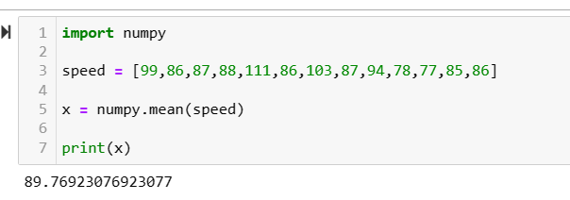
Mean using Numpy module: Jupyter notebook

Slide 28
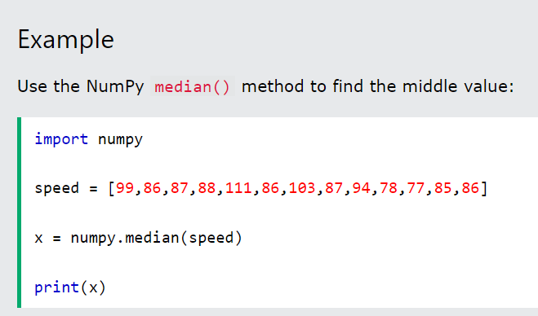
Median using Numpy module:
The median value is the value in the middle, after you have sorted all the values

Slide 29
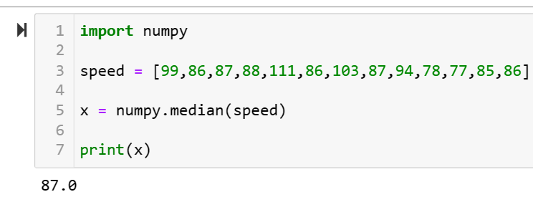
Median using Numpy module: Jupyter notebook

Slide 30
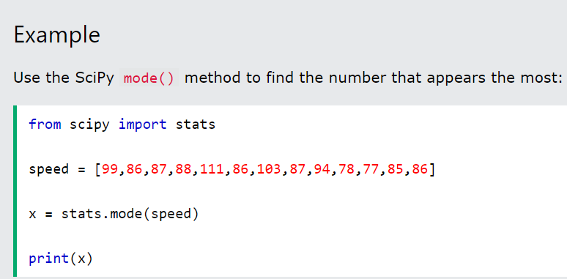
Mode using Numpy module:
The Mode value is the value that appears the most number of times.
99, 86, 87, 88, 111, 86, 103, 87, 94, 78, 77, 85, 86 = 86

Slide 31
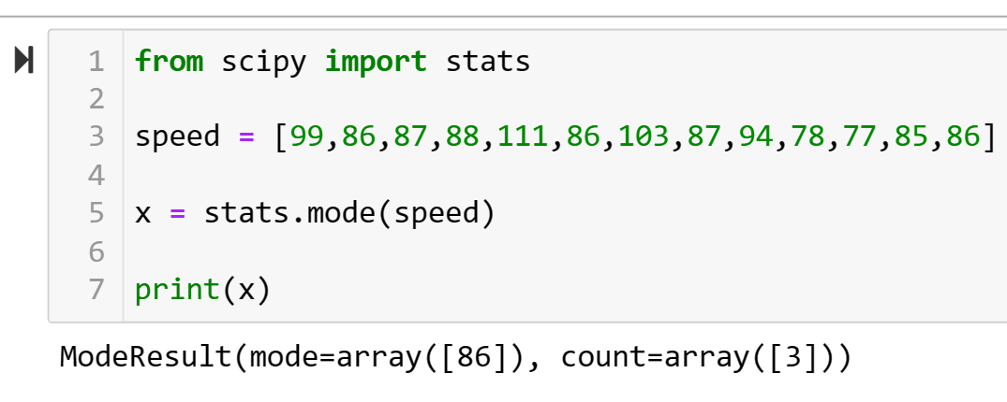
Mode using Scipy module: Jupyter notebook

Slide 32
Measure of Variability
Measures of variability are also termed measures of dispersion as it helps to gain insights about the dispersion or the spread of the observations at hand. Some of the measures which are used to calculate the measures of dispersion in the observations of the variables are as follows:
Range
Variance
Standard deviation
https://www.geeksforgeeks.org/descriptive-statistic/

Slide 33
Measures of Frequency Distribution
Measures of frequency distribution help us gain valuable insights into the distribution and the characteristics of the dataset. Measures like,
Count
Frequency
Relative Frequency
Cumulative Frequency

Slide 34
Using the computation formula for the sum of squares, calculate the population standard deviation and sample deviation for the score?
a) 1,3,7,2,0,4,3,7,
b) 10,8,5,0,1,7,9,2,1
Population Standard Deviation (σ):
σ = √(Σ(x - μ)² / N)
where:
Σ is the sum of
x is each individual value
μ is the population mean
N is the population size
Sample Standard Deviation (s):
S = √(Σ(x – x̄)² / (n – 1))
where:
Σ is the sum of
x is each individual value
x̄ is the sample mean
n is the sample size

Slide 35
Q. Compute the mean, median and mode for the following data sets
a) 45, 55, 60, 60, 63, 63, 63, 63, 65, 65, 70
b) 26.9, 26.3, 28.7, 27.4, 26.6, 27.4, 26.9, 26.9
a: 45, 55, 60, 60, 63, 63, 63, 63, 65, 65, 70
Mean
Formula: Mean = (Sum of all values) / (Number of values)
Calculation: Mean = (45 + 55 + 60 + 60 + 63 + 63 + 63 + 63 + 65 + 65 + 70) / 11 = 61.09
Median
Formula: Median = Middle value when data is ordered
Calculation:
Arrange data in ascending order: 45, 55, 60, 60, 63, 63, 63, 63, 65, 65, 70
Median = 63
Mode
Formula: Mode = Most frequent value
Calculation: Mode = 63
b: 26.9, 26.3, 28.7, 27.4, 26.6, 27.4, 26.9, 26.9
Mean
Formula: Mean = (Sum of all values) / (Number of values)
Calculation: Mean = (26.9 + 26.3 + 28.7 + 27.4 + 26.6 + 27.4 + 26.9 + 26.9) / 8 = 27.14
Median
Formula: Median = Middle value when data is ordered
Calculation:
Arrange data in ascending order: 26.3, 26.6, 26.9, 26.9, 26.9, 27.4, 27.4, 28.7
Since there are an even number of values, the median is the average of the two middle values: (26.9 + 26.9) / 2 = 26.9
Mode
Formula: Mode = Most frequent value
Calculation: Mode = 26.9

Slide 36
2.3 Correlation Analysis & Regression
Q:What is the Definition of Correlation and Regression?
The most commonly used techniques for investigating the relationship between two quantitative variables are correlation and linear regression.
Correlation refers to a mutual relationship mutual relationship or association between quantitative variables.
It can help in predicting one quantity from another.
Correlation quantifies the strength of the linear relationship between a pair of variables, whereas regression expresses the relationship in the form of an equation.
Regression analysis is a set of statistical processes for estimating the relationships estimating the relationships among variables

Slide 37
Correlation in correlation and regression can be defined as a numeric value that determines whether variables are linearly related and give a numeric value to the corresponding strength. Regression is an equation that checks how a change in one variable will result in a change in another variable.

Slide 38
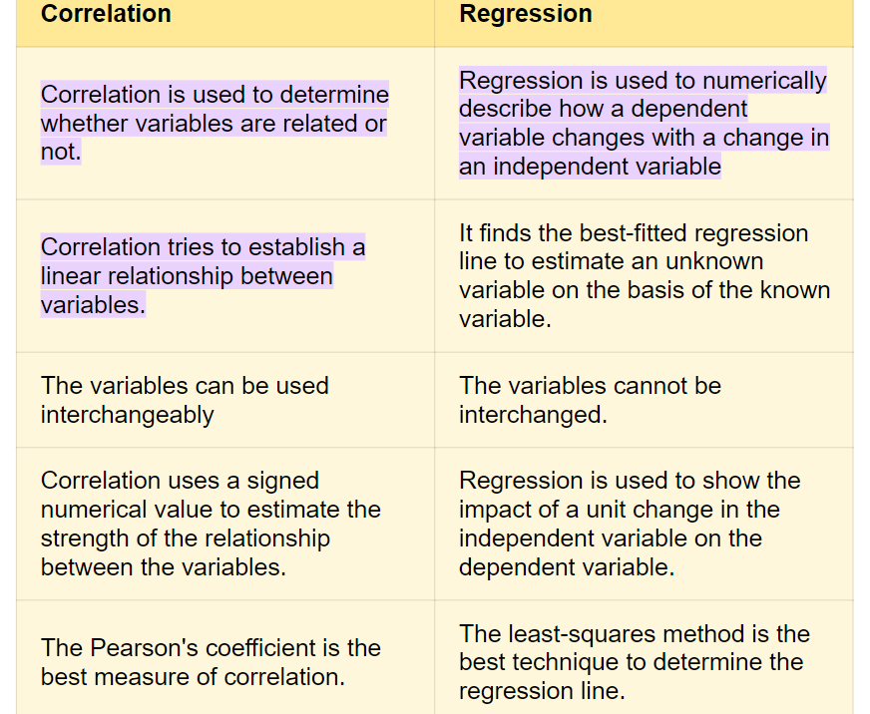

Slide 39
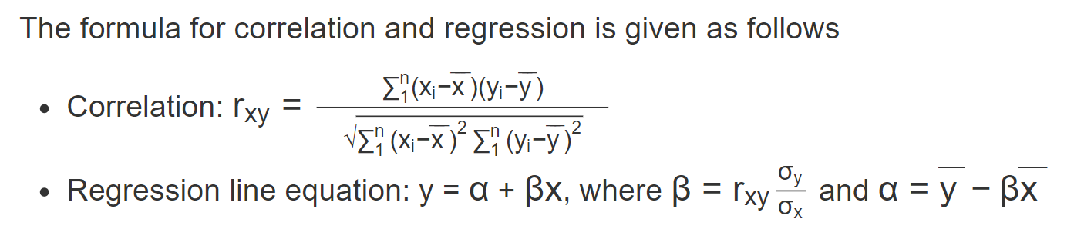
What is the Formula for Correlation and Regression?

Slide 40
What is the Similarity Between Correlation and Regression?
The similarity between correlation and regression is that if the correlation coefficient is positive (or negative) then the slope of the regression line will also be positive (or negative).
The best way to find the correlation and regression between two variables is by using Pearson's correlation coefficient and by employing the ordinary least squares method respectively.

Slide 41
Correlation Example:
Correlation refers to the statistical relationship between the two entities. It measures the extent to which two variables are linearly related. For example, the height and weight of a person are related, and taller people tend to be heavier than shorter people. You can apply correlation to a variety of data sets.
Questions and method to understand the correlation:
What Is Correlation?
What is Correlation Coefficient?
Types of Correlation Coefficient
Calculate Correlation Using Excel
https://www.simplilearn.com/tutorials/statistics-tutorial/what-is-correlation-in-statistics

Slide 42
There are three types of correlation:
Positive Correlation: A positive correlation means that this linear relationship is positive, and the two variables increase or decrease in the same direction.
Negative Correlation: A negative correlation is just the opposite. The relationship line has a negative slope, and the variables change in opposite directions, i.e., one variable decreases while the other increases.
No Correlation: No correlation simply means that the variables behave very differently and thus, have no linear relationship.

Slide 43
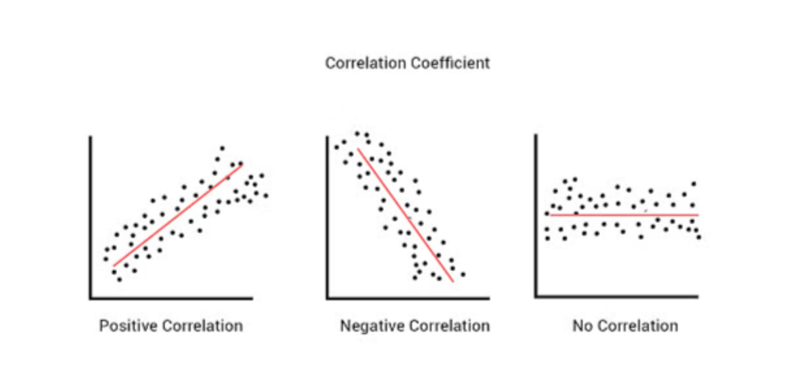
Types of Correlation:

Slide 44
2.4 Regression:
In the context of machine learning and data science, regression specifically refers to the estimation of a continuous dependent variable or response from a list of input variables, or features.
For example, it can determine which marketing channels or advertising strategies influence sales most, allowing businesses to allocate resources more effectively.

Slide 45
What is an easy example of regression?
We could use the equation to predict weight if we knew an individual's height.
In this example, if an individual was 70 inches tall, we would predict his weight to be: Weight = 80 + 2 x (70) = 220 lbs = 99 kg
In this simple linear regression, we are examining the impact of one independent variable on the outcome.

Slide 46
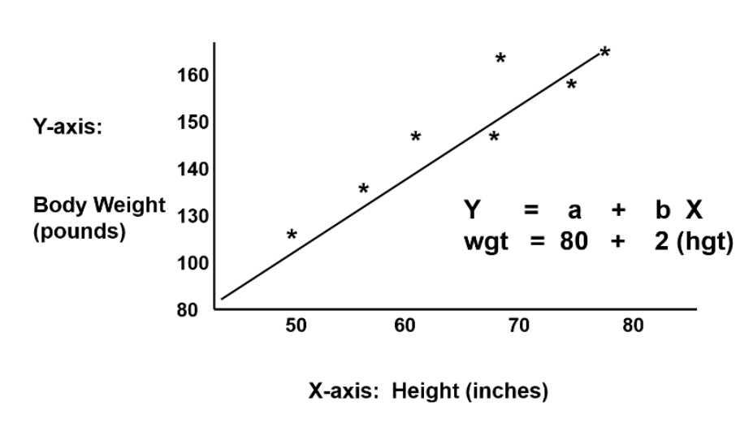
Conti…

Slide 47
2.5 Data munging
What is data munging in data science?
Data munging, also known as data wrangling, is the process of converting raw data into a more usable format.
Types of Datasets
In Statistics, we have different types of data sets available for different types of information. They are:
Numerical data sets
Bivariate data sets
Multivariate data sets
Categorical data sets
Correlation data sets

Slide 48
Essential Steps in Data Munging
There are the different stages of data munging:
Data Discovery:
Defining the purpose and goals of data analysis.
Identifying potential uses and requirements of data.
Focusing on business requirements rather than technical specifications.
Data Structuring:
Structuring raw data to make it machine-readable.
Organizing data into a well-defined schema with consistent layout (rows and columns).
Extracting data from various sources and organizing it into a formatted repository.
Data Transformation: Converting data into a consistent format, reshaping it for analysis, and creating new variables or features.

Slide 49
Data Cleansing:
Addressing data quality issues such as missing values and duplicate datasets.
Detecting and correcting erroneous data to avoid information gaps.
Applying transformations (e.g., removing, replacing, finding and replacing) to eliminate redundant text and null values, and identify missing fields and typing errors.
Data Enrichment:
Appending one or multiple datasets from different sources to generate a holistic view of information.
Aggregating multiple data sources to make data more useful for reporting and analytics.
Example: Matching an order ID against a different database to obtain further details like account name, account balance, buying history, etc.

Slide 50
Conti…
5.Data Validation:
Validating the accuracy, completeness, and reliability of data.
Final check to ensure output information is accurate and reliable.
Rejecting data that don’t comply with pre-defined rules or constraints.
Types of validation checks include consistency check, data-type validation, range and constraint validation.
Quality Assurance: Verifying the integrity and accuracy of the transformed data through validation checks.

Slide 51
Benefits of Data Munging
Eliminate Data Siloes and Integrate Various Sources:
Data munging allows businesses to break down data silos by integrating data from various sources such as relational databases, web servers, CSV files, etc.
By integrating disparate data sources, organizations can gain a comprehensive view of their data landscape, leading to more informed decision-making.
Improve Data Usability:
Data munging transforms raw data into a standardized and compatible format that is machine-readable and suitable for analysis by business systems.
By structuring and cleaning data, organizations can ensure that their data is easily accessible and usable for a wide range of analytical tasks, such as reporting, visualization, and predictive modeling.
Process Large Volumes of Data:
With the increasing volume of data generated by organizations, data munging becomes essential for processing large datasets efficiently.
By automating data cleansing and transformation tasks, businesses can handle vast amounts of data and extract valuable insights for business analytics and decision-making.

Slide 52
Conti…
Ensure High Data Quality:
Data munging plays a crucial role in ensuring high data quality by addressing data quality issues such as missing values, duplicates, and inconsistencies.
By cleaning and standardizing data, organizations can improve the accuracy and reliability of their data, enabling them to make strategic decisions with greater confidence.

Slide 53
Conti…
Good data scientists spend most of their time cleaning and formatting data.
The rest spend most of their time complaining there is no data available.
Data munging or data wrangling is the art of acquiring data and preparing it for analysis.

Slide 54
2.6 Properties of Dataset
Before performing any statistical analysis, it is essential to understand the nature of the data. We can use different Exploratory Data Analysis (EDA techniques), which helps to identify the properties of data, so that the appropriate statistical methods can be applied on the data. With the help of EDA techniques, we can check the following properties of the dataset.
Centre of data
Skewness of data
Spread among the data members
Presence of outliers
Correlation among the data
Type of probability distribution that the data follows

Slide 55
Sources of Data
• Proprietary data sources
• Government data sets
• Academic data sets
• Web search
• Sensor data
• Crowdsourcing
• Digitization

Slide 56
2.7 Collecting Data
The process of gathering and analyzing accurate data from various sources to find answers to research problems, trends and probabilities to evaluate possible outcomes is known as Data Collection.
The two methods used to gather information for research or analysis purposes are:
Primary Data Collection methods
Secondary Data Collection methods

Slide 57
Primary Data Collection Methods
Primary data or raw data is a type of information that is obtained directly from the first-hand source through experiments, surveys or observations.
The primary data collection method is further classified into two types. They are:
Quantitative Data Collection Methods
Qualitative Data Collection Methods
Quantitative Data Collection Methods
It is based on mathematical calculations using various formats like close-ended questions, correlation and regression methods, mean, median or mode measures.
This method is cheaper than qualitative data collection methods and it can be applied in a short duration of time.

Slide 58
Qualitative Data Collection Methods
It does not involve any mathematical calculations.
This method is closely associated with elements that are not quantifiable.
This qualitative data collection method includes interviews, questionnaires, observations, case studies, etc.
The various methods to collect the qualitative data are:
Observation Method
Observation method is used when the study relates to behavioral science.
This method is planned systematically. It is subject to many controls and checks.
The different types of observations are:
Structured and unstructured observation
Controlled and uncontrolled observation
Participant, non-participant and disguised observation

Slide 59
2. Interview Method
The method of collecting data in terms of verbal responses.
It is achieved in two ways, such as:
Personal Interview – In this method, a person known as an interviewer is required to ask questions face to face to the other person. The personal interview can be structured or unstructured, direct investigation, focused conversation, etc.
Telephonic Interview – In this method, an interviewer obtains information by contacting people on the telephone to ask the questions or views, verbally.
3. Questionnaire Method
In this method, the set of questions are mailed to the respondent.
They should read, reply and subsequently return the questionnaire.
The questions are printed in the definite order on the form.

Slide 60
A good survey should have the following features:
Short and simple
Should follow a logical sequence
Provide adequate space for answers
Avoid technical terms
Should have good physical appearance such as colour, quality of the paper to attract the attention of the respondent

Slide 61
Secondary Data Collection Methods
Secondary data is data collected by someone other than the actual user.
It means that the information is already available, and someone analyses it.
Published data are available in various resources including
Government publications
Public records
Historical and statistical documents
Business documents
Technical and trade journals
Unpublished data includes
Diaries
Letters
Unpublished biographies, etc.

Slide 62
Key steps in Data Collection Process:
Well-designed data collection processes include the following steps:
Identify a business or research issue that needs to be addressed and set goals for the project.
Gather data requirements to answer the business question or deliver the research information.
Identify the data sets that can provide the desired information.
Set a plan for collecting the data, including the collection methods that will be used.
Collect the available data and begin working to prepare it for analysis.

Slide 63
2.8 Cleaning Data
Data collected in raw form may not be in usable form for analysis.
Before we start analysis, a proper cleaning is required.
Cleaning of data may include
Distinguishing errors
Data compatibility / unification
Imputation of missing values
Estimating unobserved (zero) counts
Outlier detection

Slide 64
Most common types of dirty data and how do you clean them?
Duplicate Data. Duplicate data is the most common type of dirty/raw data. ...
Insecure Data. Driven by data expansion, security regulations have
transformed the marketing landscape. ...
Outdated Data. ...
Incomplete Data. ...
Inaccurate Data. ...
Incorrect Data. ...
Inconsistent Data. ...
Hoarded Data

Slide 65
Common steps in the data cleaning process, as mentioned below.
Removing duplicates
Remove irrelevant data
Standardize capitalization
Convert data type
Handling outliers
Fix errors
Language Translation
Handle missing values

Slide 66
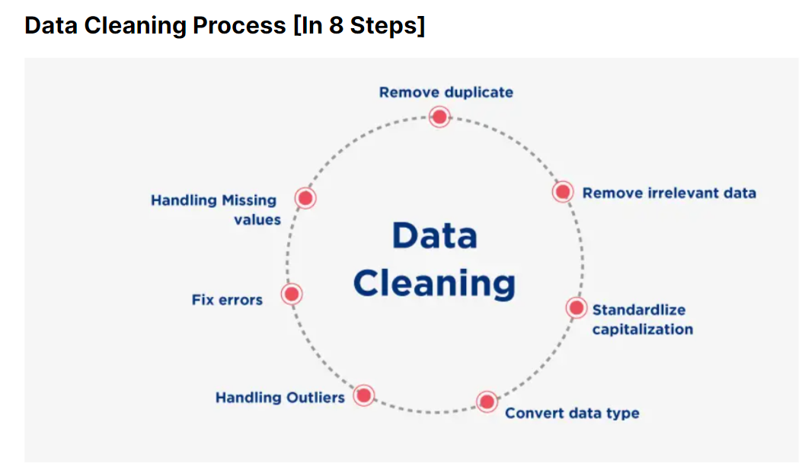

Slide 67
Data cleaning tools:
Excel
Python
SQL
Tableau
Benefits of Data Cleaning in Data Science:
Avoiding mistakes
Improving productivity
Avoiding unnecessary costs and errors
https://www.knowledgehut.com/blog/data-science/data-cleaning

Slide 68
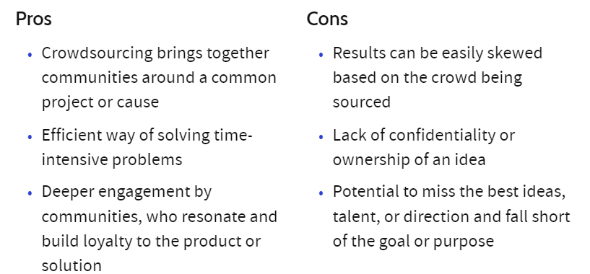
2.9 Crowdsourcing
Crowdsourcing involves obtaining work, information, or opinions from a large group of people who submit their data via the Internet, social media, and smartphone apps.

Slide 69
Crowdsourcing
• Many amazing open data resources have been built up by teams of contributors: –
- Wikipedia/Freebase
- IMDB
Crowdsourcing platforms like Amazon Turk enable you to pay for armies of people to help you gather data, like human annotation.

Slide 70
Crowdsourcing types and examples:
Wisdom - Wisdom of crowds is the idea that large groups of people are collectively smarter than individual experts when it comes to problem-solving or identifying values.
Creation - Crowd creation is a collaborative effort to design or build something. Wikipedia and other wikis are examples of this. Open-source software is another good example.
Voting - Crowd voting uses the democratic principle to choose a particular policy or course of action by "polling the audience.“
Funding - Crowdfunding involved raising money for various purposes by soliciting relatively small amounts from a large number of funders.
Netflix, Amazon…etc…

